Slide 1

Team 7: Erik, Jacob, Jack, Alex

Slide 2

Background
Year Established: 1903
Headquarters: Dearborn, Michigan
Companies Owned by Ford: Lincoln, Troller, Ford Motor Credit Company, LLC, Ford Motor Land Development Corporation (Ford EU, 2021)
Global Industry Growth Rate: 9.7% in 2021 (IBIS World, 2021)
Competitors: General Motors, Toyota, Honda, Tesla (Forbes, 2021)
Vision: to become the worlds most trusted company, designing smart vehicles in a smart world
Mission: to help build a better world, where every person is free to move and pursue their dreams
Values: integrity, transparency, inclusion, curiosity, creativity, resiliency, teamwork
(Ford, 2021)

Slide 3
Strategic Group
High
Mercedes-Benz
BMW
Audi
Price
Ford
Honda
GM
Toyota
Low
Luxury
High

Slide 4
Stakeholder analysis
Stakeholder | Level of Influence | Estimated Impact of Interests | Explanation of Interests
Consumers | 1 | + | - Product innovation for fuel economy, safety, and autonomous driving
Employees | 1 2 | + + | - Sustainable workforce - Individual training and development
Shareholders | 1 | + | - Financial growth
Multi-Stakeholder Initiatives | 1 2 | + + | - Industry expansion - Sustainability

Slide 5
External analysis - Pestel
Economic
Sales improvements due to product trade between China and India
Increasing Consumer Income
Open trading allows saturation of market
Political
Instability in Euro Countries
Increasing effort in developing countries
Support for technological innovation
PESTEL
Socio-Cultural
Increasing demand for hybrid/electric options
Moderate view on customer service
Market Saturation
Technological
Consumer Desire for high tech cars
Balance between consumer needs and technological incorporation
Autonomous vehicle investment
Environmental
Climate Change
Low Carbon Trend
Declining Oil Reserves
Legal
Safety test struggles
Transmission and Fuel System Issues

Slide 6
External analysis – Porter's Five forces
Moderate Supply and Population
Ford River Rogue Complex
Low forward vertical integration
Threat of New Entrants
WEAK
High Capital Costs
High Cost for Business
High Cost for Brand Development
Rivalry Amongst Competitors​
STRONG
a
High Aggressiveness of Firms ​
High Exit Barriers
Moderate Number of Firms
MODERATE
Bargaining Power of Suppliers
Bargaining Power of Buyers
MODERATE
Low Performance of Substitutes
Moderate Switching Costs
Moderate Number of Substitutes
Moderate Switching Costs
Moderate availability of Substitutes
Threat of Substitutes
MODERATE

Slide 7
Strategic alliances
Ford and Redwood Material
Ford and Redwood announced an alliance for closed-loop battery recycling in order to push the production of the F-150 Lightning Truck. This announcement also came with the announcement of the Blue Oval City, an electric battery complex to further push the manufacturing of batteries for their EV models of their vehicles (Ford Media, 2021)
Ford and Google
In February 2021, Ford and Google announced a six-year strategic partnership where Ford will introduce an Android operating system and use technology from Google for all technology processes in the Ford ecosystem (Detroit News, 2021)

Slide 8
Internal analysis – value chain
Inbound Logistics
Operations
Outbound Logistics
Marketing and Sales
Services
Raw materials from suppliers
Internal distribution of raw materials
Distributed manufacturing plants
Numerous research and development facilities
Distribution of manufactured vehicles from plants to dealerships
Substantial expenditures on brand promotion and advertising
Internal research and development
Growth of financial services division
Supporting Activities:
Human Resources: continuous development opportunities offered to employees; training and education
Accounting and Finance: growth of financial services division shows strong internal accounting and finance practices
Procurement: strong supply chain means lower raw material and transport costs which can pass savings to customers
(Lawaspect, 2020)

Slide 9
Internal analysis - vrio
Resource and Capabilities | Value (V) | Rare (R) | Costly to Imitate (I) | Organized to Capture Value (O) | Sustained Competitive Advantage?
Strong Brand | Yes | Yes | Yes | Yes | Yes
Distribution | Yes | Yes | Yes | Yes | Yes
Marketing | Yes | No | Yes | Yes | Competitive Parity
Green Tech | Yes | No | Yes | Yes | Competitive Parity
New Tech | Yes | No | No | Yes | Competitive Parity
Safety | Yes | No | No | Yes | Competitive Parity
Leadership | Yes | Yes | No | Yes | Temporary Advantage
(Embapro, 2021)
(Think Insights, 2021)

Slide 10
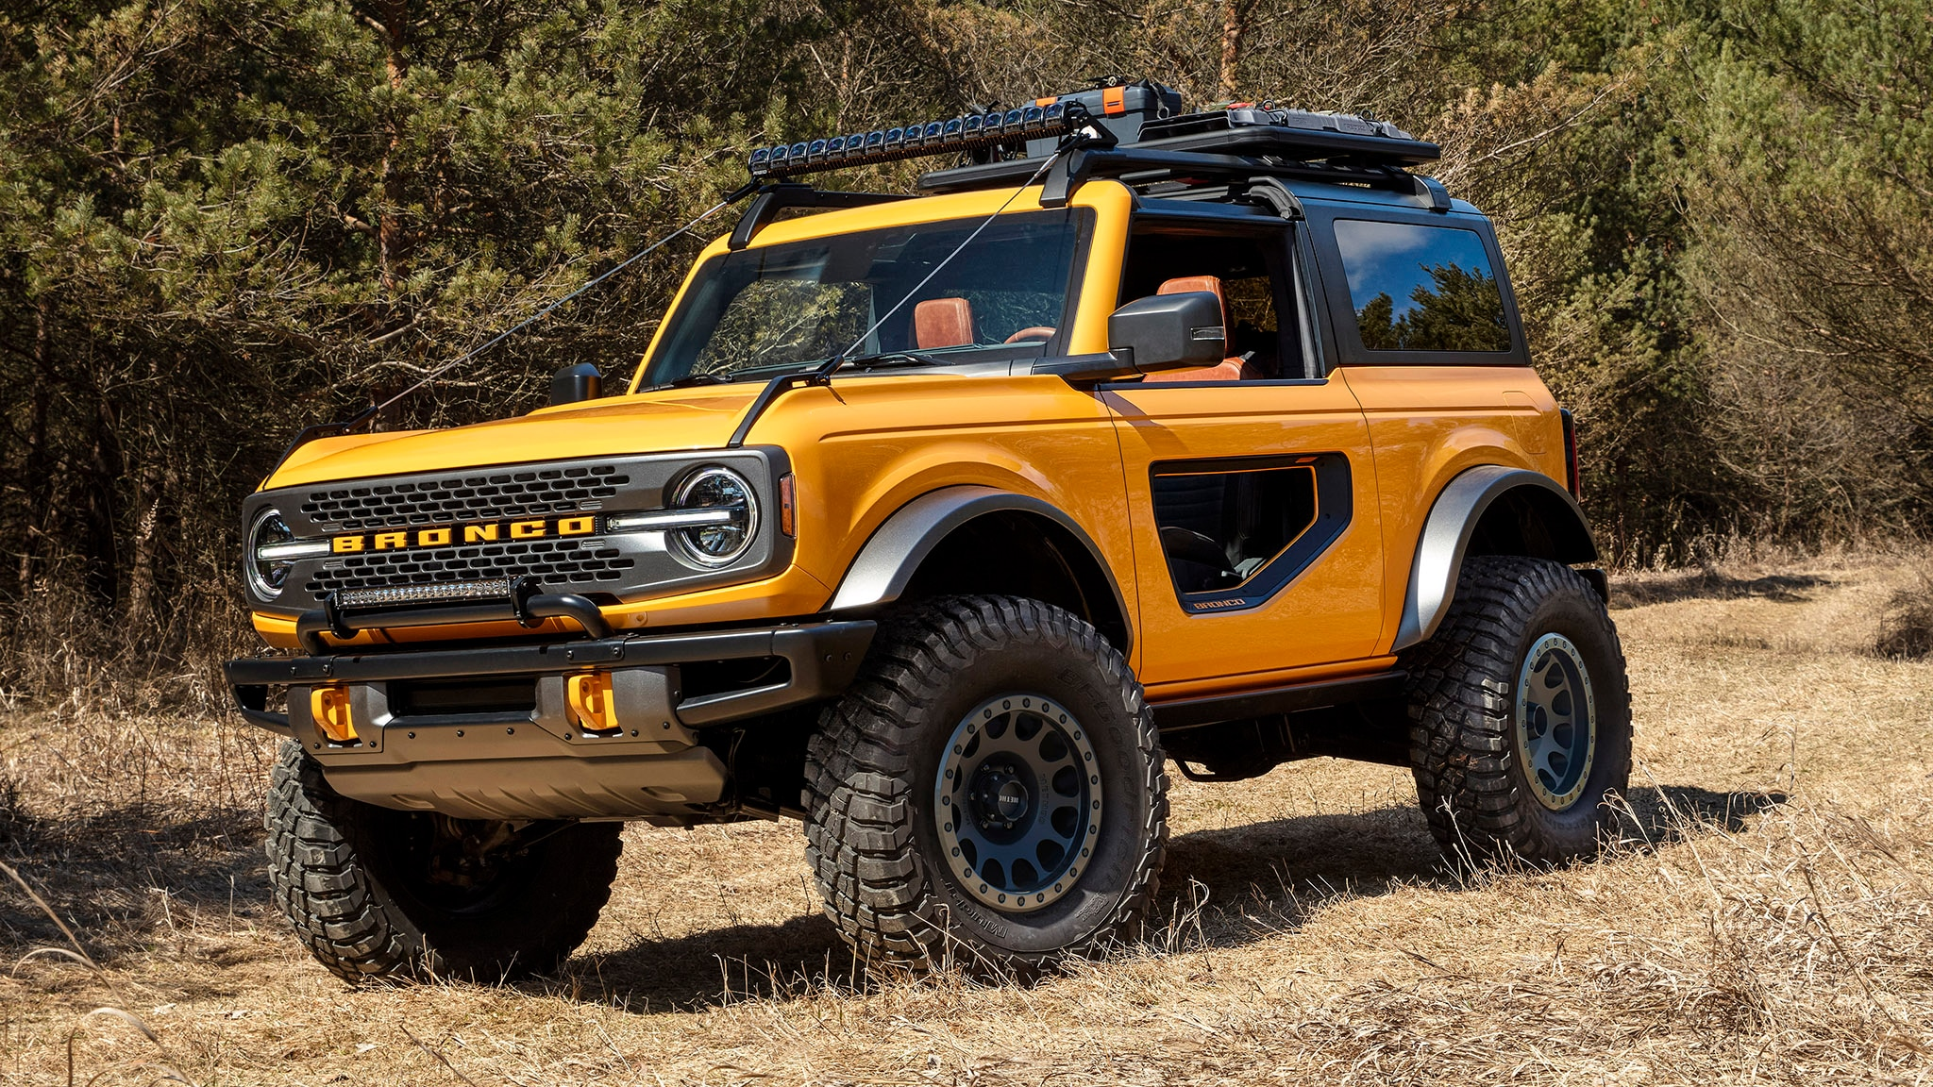
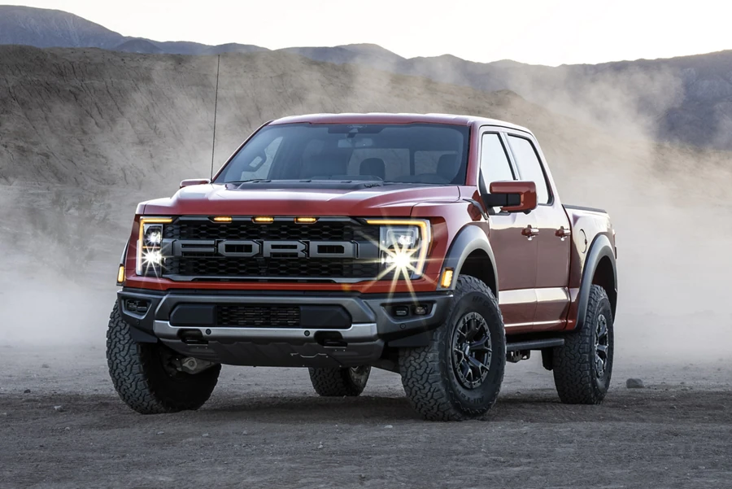
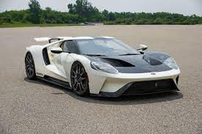
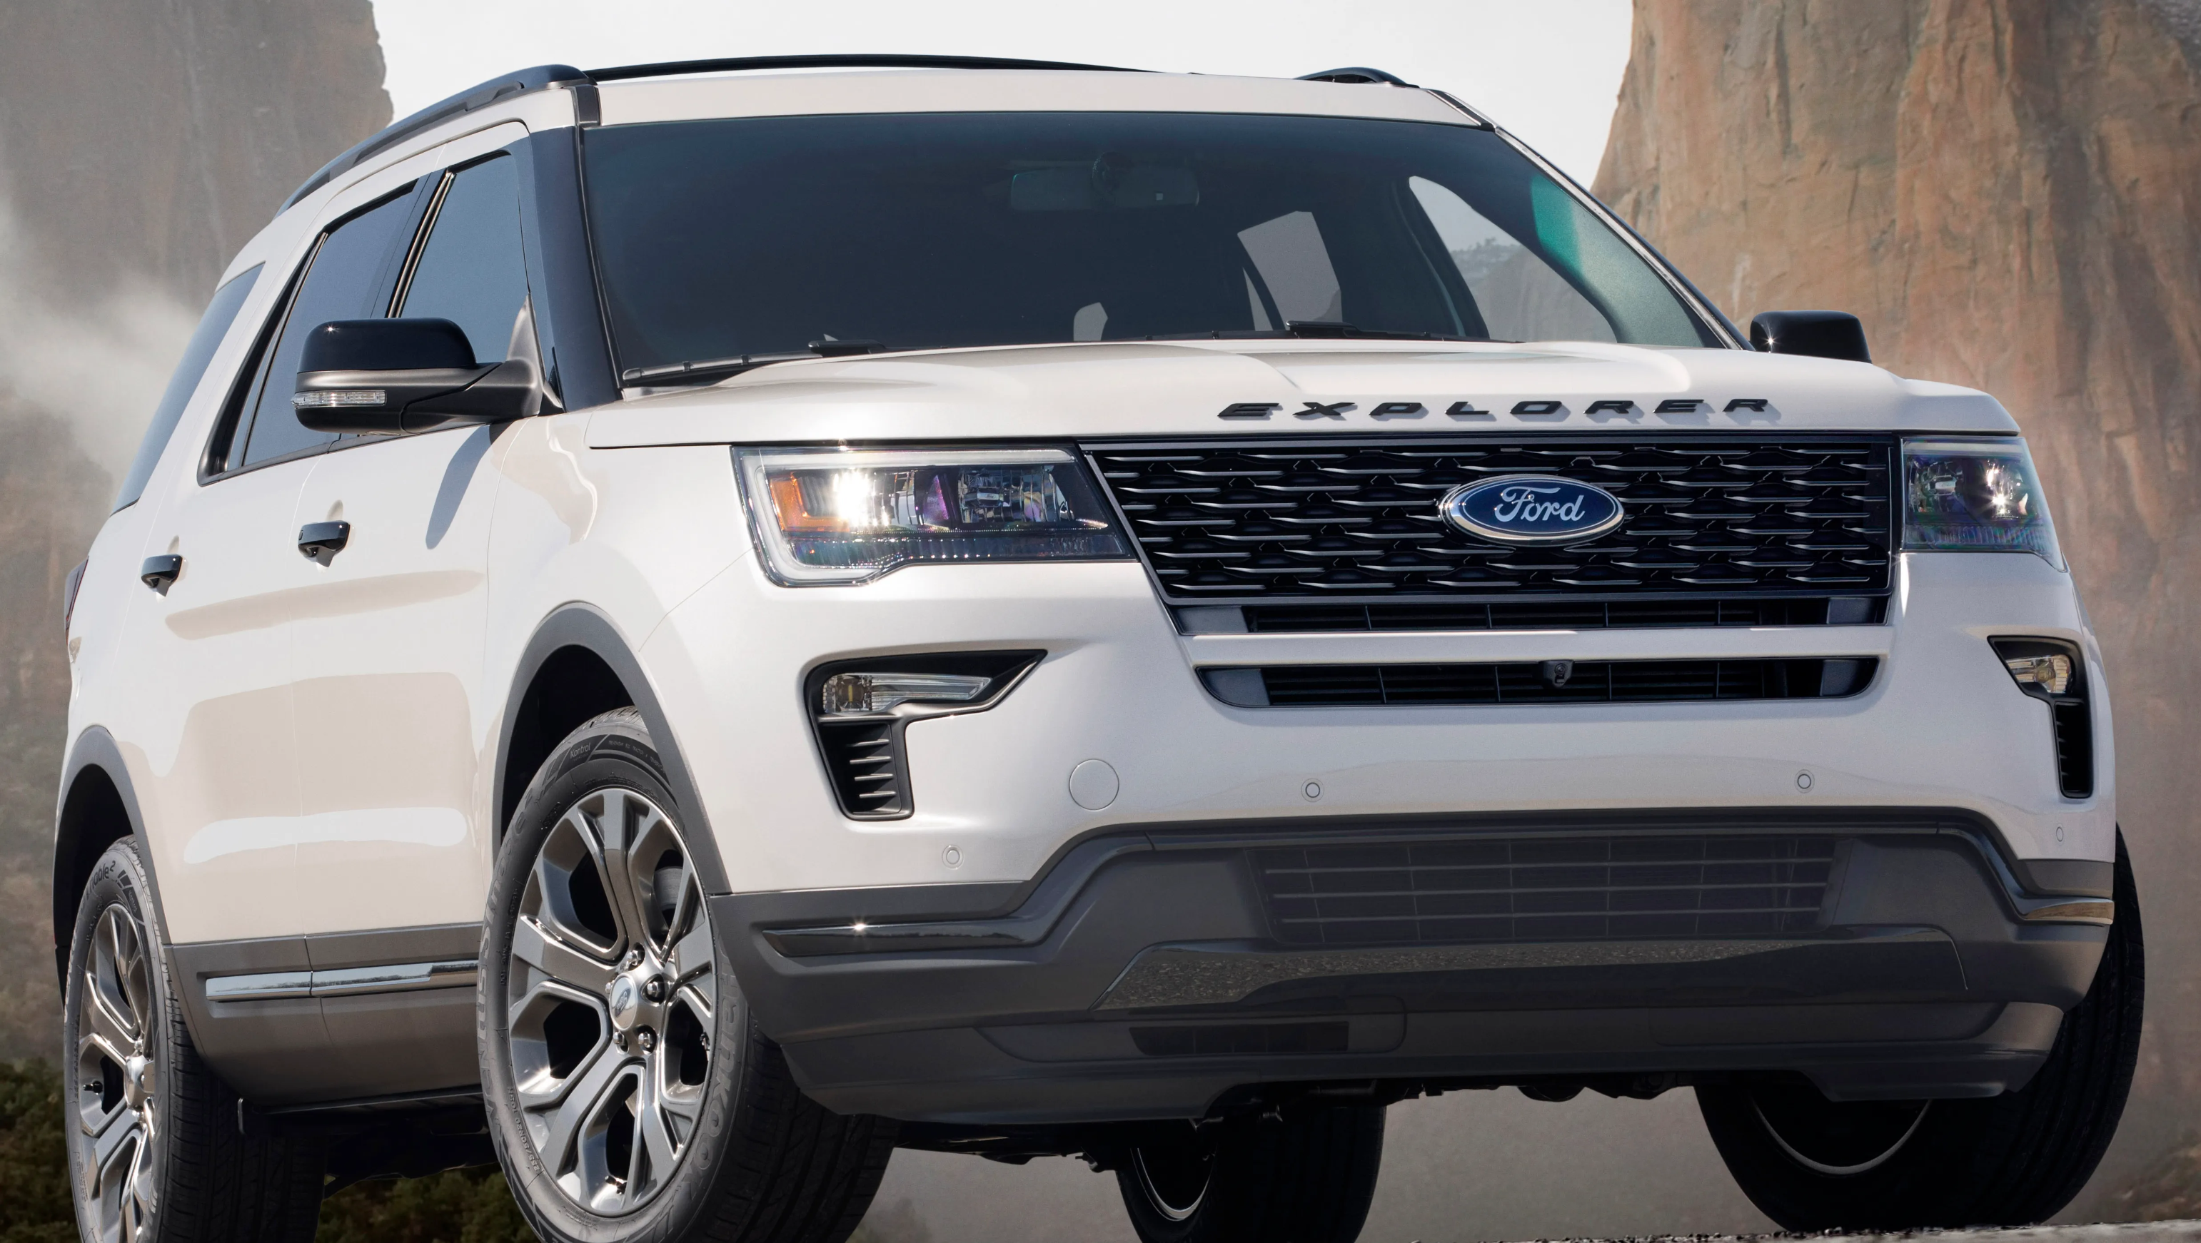
BCG Analysis
High
Question Marks
Stars
Bronco
F-Series Trucks
Industry Growth Rate
Dogs
Cash Cows
Low
GT/Mustang
SUVs
Low
Relative Market Share
High

Slide 11
STRENGTHS
Strong brand name contributes to customer loyalty (S1)
Global supply chain that supports operations internationally (S2)
Commitment to making/developing new products through research and development (S3)
Wide product/service portfolio provides leverage and less dependency on just one product range (S4)
Diverse offerings that cater to the wants and needs of all demographic groups (S5)
WEAKNESSES
Heavily dependent on US markets (W1)
Overdependence on truck and SUV sales (W2)
Do not have stronghold in emerging markets due to lack of focus in productivity and performance (W3)
Poor reputation compared to luxury car brand competitors (Lincoln) (W4)
OPPORTUNITIES
Being technologically adaptive with eco-friendly vehicles (O1)
Increase customer base globally, specifically in smaller countries (O2)
Enhance digital marketing skills to grow its customer and supplier engagements (O3)
Self-driving car – partnerships with other companies to innovate the future of grocery delivery (O4)
Expanding operations into related fields such as software and electric vehicle charging (O5)
THREATS
Struggles to maintain innovative position in already cut-throat competitive industry (T1)
Increase in compliance and regulatory threats due to environmental improvements (T2)
Increasing raw material prices(steel) can affect the company's profit margin (T3)
Market uncertainties that have recently affected the company more adversely than its competitors (T4)
(Strategy Hub, 2021)

Slide 12
Strengths
Weaknesses
SO1 (S3O1): Utilize competent research and development to increase their stance in the eco-friendly vehicle market SO2 (S4O4): Continue to broaden product/service portfolio by investing resources into AI (self-driving cars) SO3 (S5O3): Develop their digital marketing strategies to increase variety of demographic groups | WO1 (W1O2): Capitalize on the brand built in the US and start to allocate resources to build markets in smaller countries WO2 (W4O1): Invest resources into making luxury car brand (Lincoln) more eco-friendly to compete with Tesla WO3 (W3O3): Utilize digital marketing opportunities to reach emerging markets
ST1 (S1T2): Use strong brand name and build customer loyalty by becoming more environmentally friendly ST2 (S4T1): Find ways to add innovation to already wide product portfolio ST3 (S2T4): Utilize global supply chain and international supply chains to reduce effects of market uncertainties | WT1 (W2T2): Place emphasis on increasing sales outside of trucks and SUVs due to the way these vehicles effect the environment WT2 (W1T1): Increase efforts to reach markets oversees to seek out innovative opportunities like competitors do in the US
Opportunities
Threats
(Strategy Hub, 2021)

Slide 13
Critical success factors
Description
Priority
CSF #1
(WO3)
Appeal to emerging demographics; shift focus towards appealing to markets beyond US- specifically those with rapid growth.
1
CSF #2
(SO3)
Promote sales and marketing efforts of vehicles following the decline of vehicles sales during the pandemic
2
CSF #3
(SO1)
Continue research and development into Ford Models that are more hybrid and fully electric in order to appeal socio-cultural and ecological appeals
3

Slide 14
Direction
 | Description | Pros | Cons
Strategic Recommendation | Promote and expand Ford to new markets with growing open international trade | New Markets International branding | Growing exporting costs New international marketing strategies
Strategic Recommendation | Promote new branding of vehicles that are hybrid and electric | Eco-Friendly reputation | Continuous R&D Large investments into battery plant
Strategic Recommendation | Continue research and innovation towards Autonomous driving cars | Compete with the growing autonomous/semi-autonomous growing market | Continuous R&D Costly R&D Long implementation timetable

Slide 15
Implementation – EV Goals
Develop all electric vehicle for European market capitalize on new opportunities
Create their own "gigafactory" to create their own batteries for EV's
Expand their network of charging plugs
2021
2022
2023
2024
2025
Expand Rouge complex & increase production of EV F-150's & Mustangs
Invest EV sales capital into accelerated R&D for batteries
(Ford Media, 2021)

Slide 16
key performance indicators
#1
#2
#3
#4
#5
Corporate: Percent of revenue generated outside of North American sales
Present: 37%
Future: 50%
Functional: EV charging revenue generated by Electriphi acquisition
Future: $1 billion
Business: Percent of sales from EVs
Present: 1.2%
Future: 40%
Corporate: Total vehicle unit sales
Present: 4.2million
Future: 5.5million
Corporate: Return on investment
Present: 2.2%
Future: 3.2%
(Statista, 2021)

